Slide 1
Why we need Racism

Slide 2
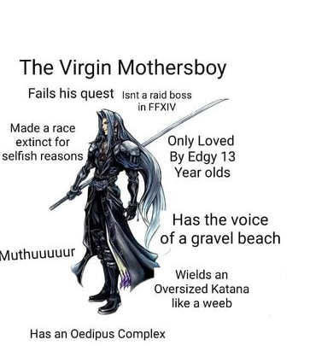
3 (of many) Final Fantasy antagonists that are better than Sephiroth

Slide 3
Kefka
literally crazy (with backstory)
just wants to destroy stuff
Chad attitude
iconic laugh
Become god of magic and destroyed the entire world

Slide 4
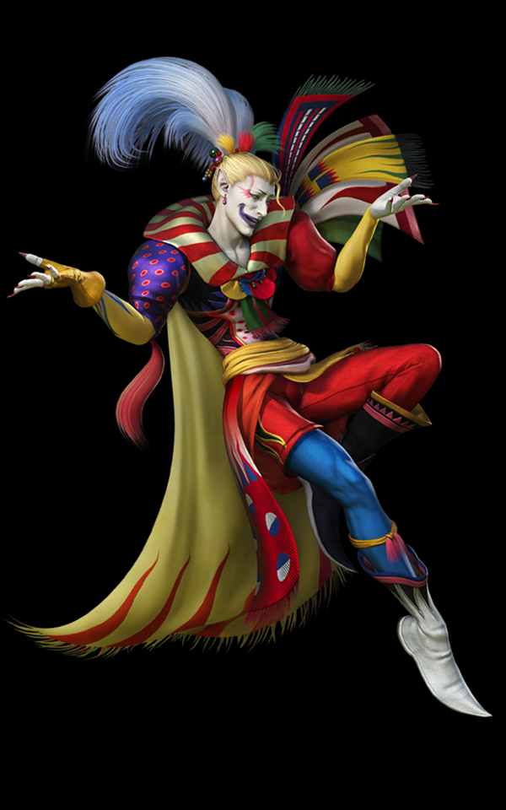
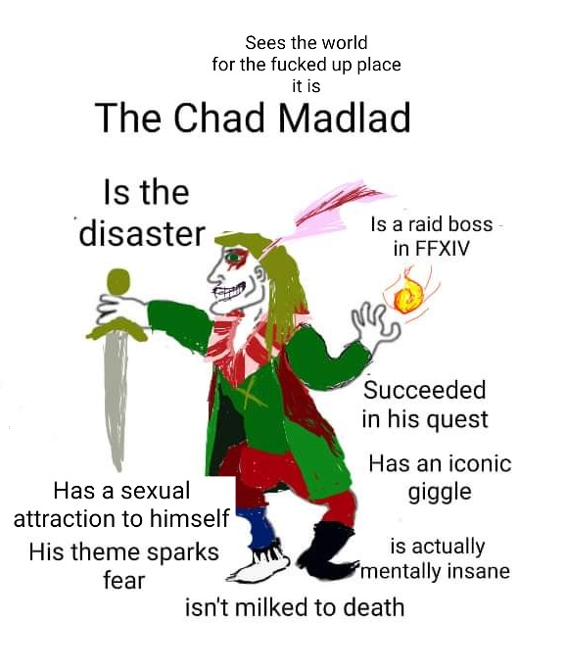

Slide 5
Cloud of Darkness
- Is Beautiful
- Emissary of Void
- Timeless and eternal entity who will always exist to consume the world
- defeating it merely sends it to sleep
- actually killed the Heroes of Light (the Protagonists)

Slide 6
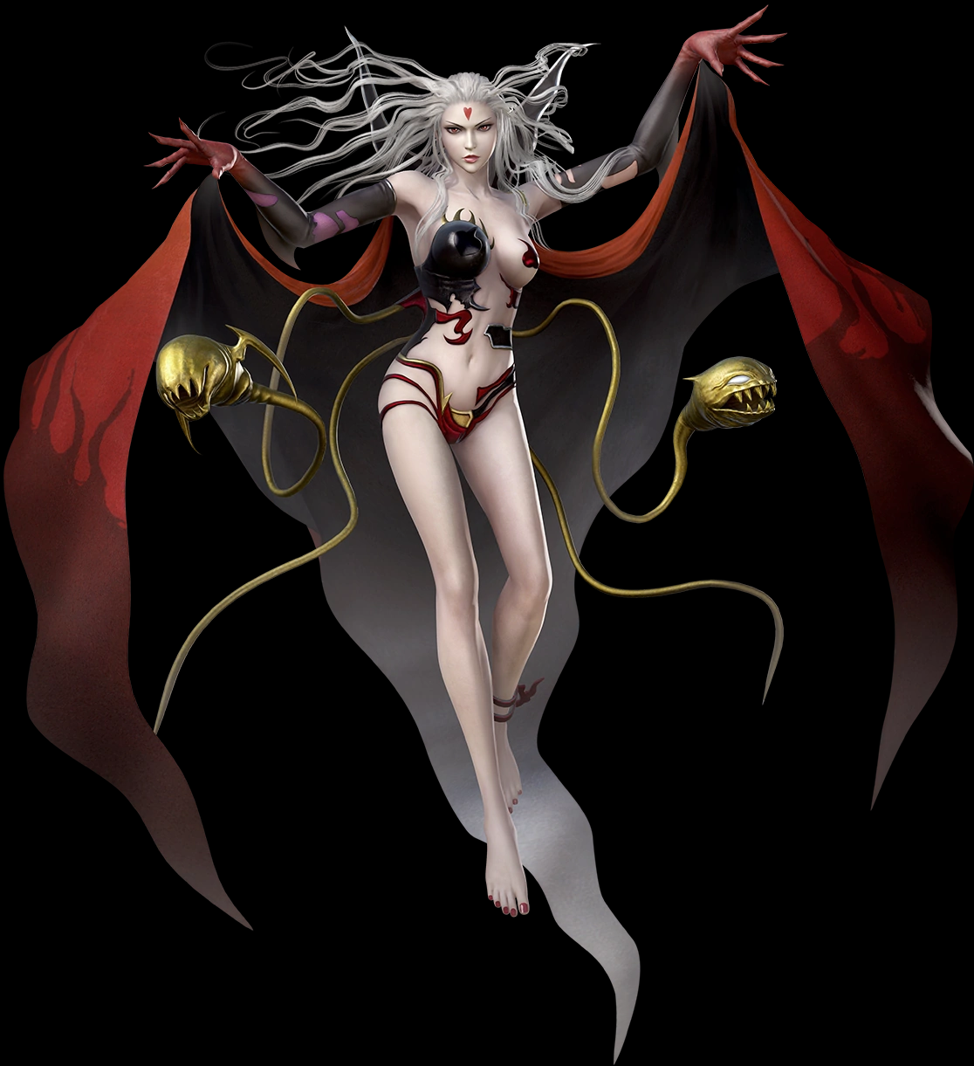
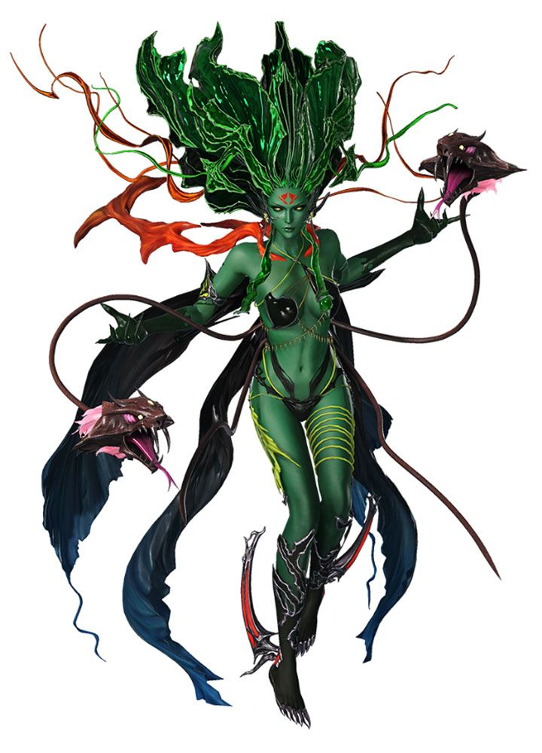

Slide 7
3. Kuja
Fabulous and elegant
Knows how to create Black Mages artificially
Controls Silver dragons and a literal Divine Dragon
Angel of Death
Never got defeated by the good guys (last fight ends in a draw)
never developed human emotions

Slide 8
